Slide 1
Read Me: This deck contains two sections. One for participants and a second for coaches.
Participant section
This top section is a Tech Scenario description for participants. The section will cover the technology introduction and high-level concepts about the challenges.
Audience: Participants at OpenHack
Coach only section
This section is a Tech Scenario description for coaches. The section will cover the technology, challenge goals, common pit falls, general guidance on solutions. This section is presented to coaches in the ‘know before you go’ call a few days before the OpenHack starts. This section is intended to be more in-depth than the participant section. Do not share the coach section with participants!
Audience: Coaches at OpenHack
Section 1
Section 2

Slide 2

Microsoft Azure Well-Architected Framework
#MSOpenHack

Slide 3
Microsoft Azure Well-Architected Framework
Technologies
Azure DevOps
Azure Bicep/ARM Templates
Azure Key Vault
Azure Traffic Manager
Azure Virtual Machines
Azure App Service
Azure SQL
Azure Load Balancer
Azure Application Gateway – WAF v2
Azure Cost Management
Azure vNets
Azure Private Endpoints
Azure Monitor
Azure Defender
Azure Sentinel
Grafana
Become familiar with the benefits and the scope of the Microsoft Azure Well-Architected Framework’s pillars: cost optimization, operational excellence, performance efficiency, reliability, security.
Apply the Microsoft Azure Well-Architected Framework to a workload using the ACHIEVE method: assess, consider, hypothesize, improve, validate
Effectively communicate the Microsoft Azure Well-Architected Framework and become equipped for delivering assessments for the Microsoft Azure Well-Architected Framework and Go-Live.

Slide 4
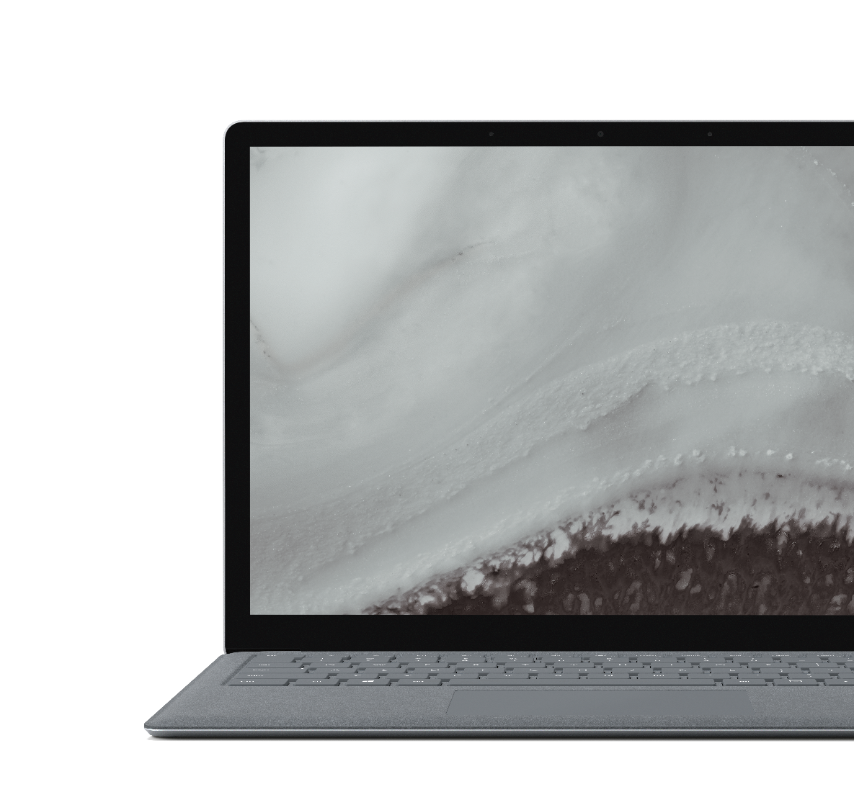
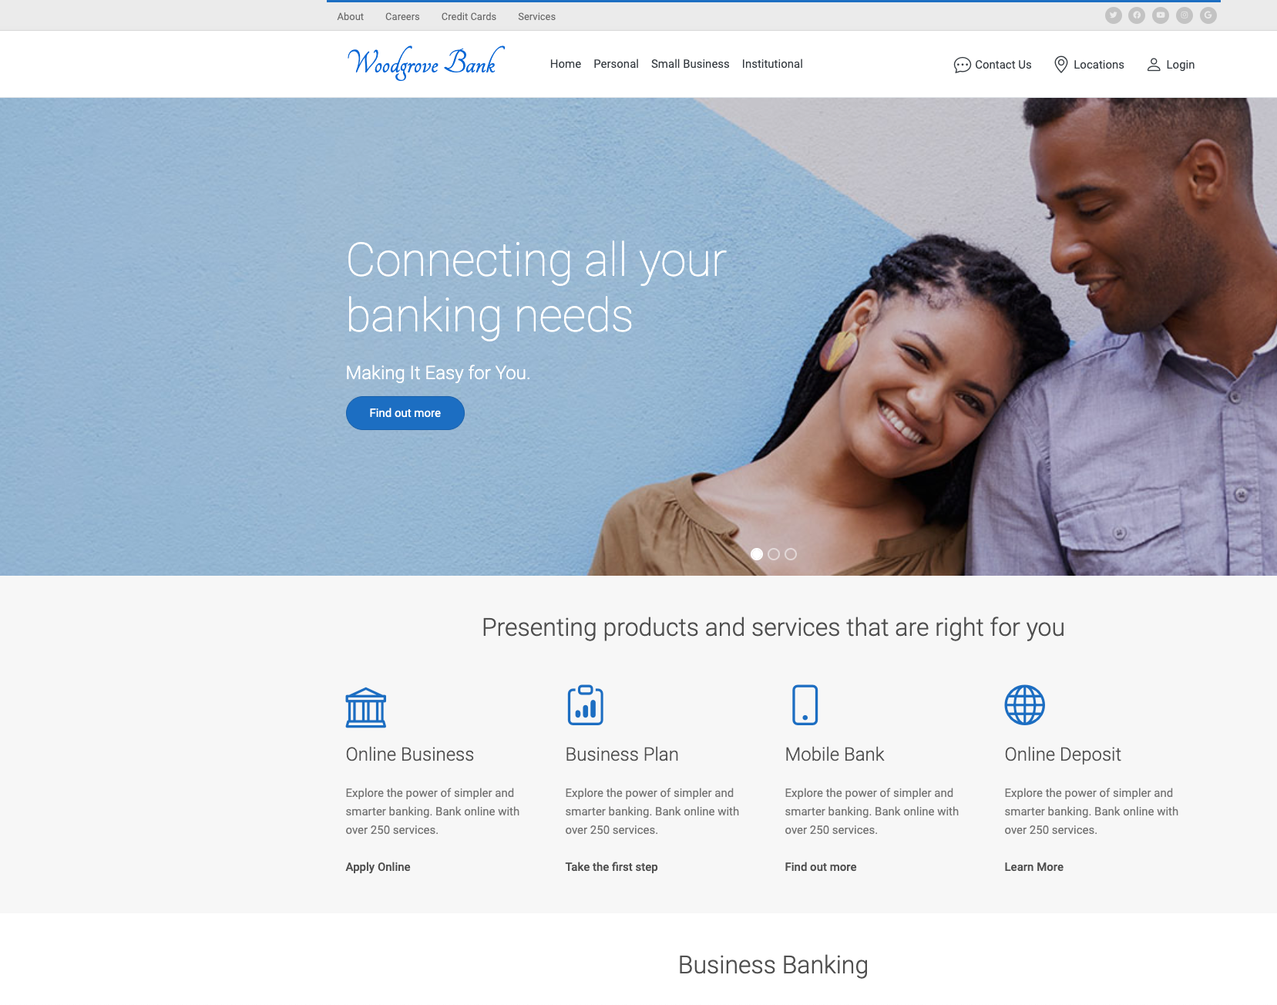
Scenario
Woodgrove Bank
Adopting Azure and moving on-premises applications from data centers.
The web application is used by customers to check account balances.
Background, nightly service job processes posted transactions.
The mission is to evaluate current workload, then plan and implement WAF principles
The success of teams depends on their ability to not only execute a challenge, but also provide enough reasoning for the choices they make.
Notes:
During the OpenHack, your team will evaluate Woodgrove Bank’s initial attempt to move an application into Azure.
The legacy application is in the middle of a re-architecture for the purposes of leveraging a microservice approach. Woodgrove Bank has reached their limit in knowledge and is reaching out to Microsoft for next steps.
While working through this OpenHack, your team will practice evaluating workloads through lenses of the 5 WAF pillars. You will then make recommendations and provide instruction to Woodgrove Bank as your transform their IaaS workload. Once the workload is WAF-optimized, you will then modernize the workload by transitioning it to PaaS, where applicable.
Throughout all challenges, you must maintain rigorous attention to the core principles of each WAF pillar.
Any resemblance to actual scenarios, issues, or pain points that you are facing is not purely coincidental. The definitions of the challenges that will be presented to you during this event are inspired by real life.

Slide 5

Migration
The challenges in this OpenHack are based on real world and validated scenarios from both the Microsoft field and customers
Know your stakeholders
Calculate your cost
Perform discovery
Plan your migration
Identity and governance
Determine a strategy to minimize downtime and accelerate migration
Test in isolation
Select the right tools
Transform IaaS to PaaS with minimal downtime
Improve with on-demand resource availability
Implement rich security
Data protection
Monitor and triage

Slide 6
Feedback
Goal-Oriented – It states what is trying to be accomplished by the user
Specific – Gives details about the scenario, observations, and/or challenges faced by the user
Actionable – Provide necessary clarifying information to enable a decision

Slide 7

Let’s get started!
aka.ms/OHPortal
Login with the credentials supplied to your team.
Notes:
To get started, visit the OpenHack portal:

Slide 8
Microsoft Azure Well-Architected Framework
Challenge walkthrough for coaches

Slide 9
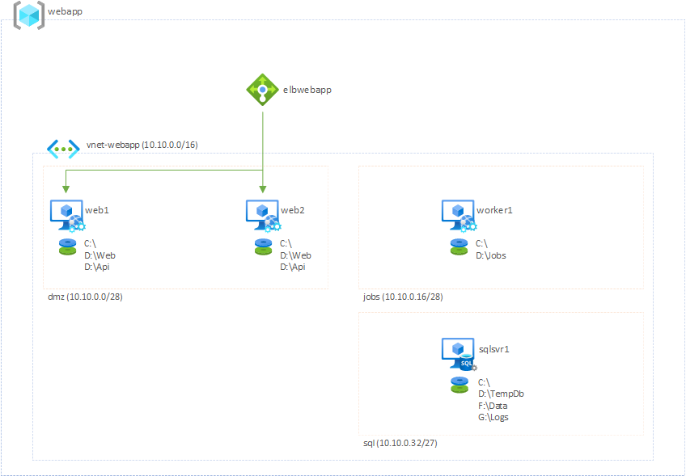
Architecture
1 resource group
1 external load balancer
1 vnet
3 subnets
dmz
jobs
sql
4 vms
2 web servers
1 background service server
1 sql server

Slide 10
Architecture – Application
Customer Portal
Frontend – Razor Pages
Backend – WebAPI
Background Service
Console App (Timer Job)
Database
SQL Server 2014 SP3
* Razor Pages and WebAPI both exist on the same web server, but two different web applications in IIS

Slide 11
Challenge timing guidance
You need to "watch the clock" for your table
Do not pressure your table to move faster if they are behind
Engage your lead coach(es) to discuss strategies for providing additional guidance to your table
Ask them if they have read the links in the Reference section of the challenge
Keep your table on task
You are expected to participate with the team. Their success highly depends on your active participation.
For each challenge, encourage them to plan as a team and discuss their plan with you before implementation
Encourage your team to pay close attention to each challenge’s cheat sheet and success criteria
Every challenge will require something delivered by the attendees
You are encouraged to engage your table and make sure they know to check with you prior to implementation in each Challenge
Success in each challenge will require participation by all team members – infra, dev, data, security

Slide 12
Success Matrix
Challenges require teams to meet or exceed core learning objectives
Success Matrix has been provided to ensure that teams accomplishments are measured objectively
Success Matrix is located under “Coach Resources” in the Opsgility Sandbox
Team is required to satisfy 80% of the core learning objectives in order to pass the challenge
Do NOT share the Success Matrix with the team

Slide 13
Challenge timing and common strategies to accelerate
Challenge 3
Point out AAD Connect documentation
https://docs.microsoft.com/azure/active-directory/hybrid/how-to-connect-install-express
https://docs.microsoft.com/azure/active-directory/hybrid/how-to-connect-install-custom
Challenge 4
Reminder that only CMAD1 and CMVPN1 need connectivity to Azure
Alter the requirements for AD availability to 99.9% (Single instance VM with Premium disk)
Challenge 5
Migrate only the public web app
Challenge 6
Migrate only the public web app
Point out that files can be copied via FTP
https://docs.microsoft.com/azure/app-service/deploy-ftp
Challenge 8
Migrate only the public web app

Slide 14
For each challenge
Introduce the Challenge and provide your expectations for the table
Do NOT share the Success Matrix with the team. However, you can share some general expectations with the team.
Encourage your team to plan and verify their plan with you
Reinforce Reference links available for the Challenge
Verify the plan for the Challenge with your table and have them proceed
After your table completes the Challenge, review the Success criteria with them
As the Success Matrix states, the team MUST acquire an 80% or higher grade across the core learning objectives.
As a part of the Challenge retro, make sure you are calling out edge cases and / or differences in how the table solved the Challenge versus how the work would be performed at a customer site or in their own environment
This is a critical step! Do not let your table take away bad habits!

Slide 15
Environment stability
The environment is considered “production.” All changes must be non-destructive.
Changes to the environment should be automated and conducted through Azure Bicep/ARM templates.
Teams should highly leverage Azure DevOps for automation.

Slide 16
Challenge 0 MVP

Slide 17
Challenge 0 MVP
While there is no official Challenge 0 in the attendee guide, there are some things you can do to ensure you'll have a successful and productive hack
Encourage attendees on high DPI Windows devices such as Surface Books to install mRemoteNG to mitigate DPI scaling issues in the native Windows RDP client (note that this is not a requirement for this OpenHack, simply a lifehack)
Have attendees not only read the overview, but also
Login to their Azure subscription and explore the resources that are deployed
Login to their Azure DevOps tenant to ensure all repositories are there
Attendees should be very aware that they are working with a "production" environment before they get hands on keyboard

Slide 18
Challenge 1 Asses the environment

Slide 19
Challenge 1 MVP
This challenge is all about understanding the customer’s environment
Attendees should be targeting people, process, and technology
People
What roles will attendees take on?
What skillsets are at the table?
Process
How are they going to communicate?
How are they going to come to consensus on tooling?
Technology
Given the team’s knowledge, what tools and resources will be needed to satisfy the challenge requirements
Team should identify any knowledge and technical gaps

Slide 20
Challenge 1 success criteria
Attendees will need to be able to describe each pillar of the Microsoft Azure Well-Architected Framework along with each respective pillar’s core principles.
The attendees should have a list of all components in the architecture and demonstrate that they have researched the configuration.
Attendees should list any concerns in the application and its supporting architecture.
Attendees should demonstrate how to perform a Cost Analysis on the current subscription.
Attendees should add tags to the resources in the current workload based on department and demonstrate how to filter costs based on the department.
Attendees should use the Azure Pricing Calculator to estimate costs of future workloads.
Attendees should demonstrate and document load testing of the application.
Attendees should demonstrate and document stress testing of the application.
NOTE: A more complete set of success criteria, along with hints/suggestions, and coach references are available in the coach’s guide.

Slide 21
Challenge 1 responses
What are the pillars of the Well-Architected Framework?
What components have been identified in the customer’s architecture that are specific to:
Infrastructure
Application
Security
What improvements can be made in the customer’s architecture that are specific to:
Costs
Operations and management
Performance
Security
Reliability
How is a cost analysis performed?
How can someone filter components to identify costs related to workloads/departments/etc.?
What tools can one use to better determine costs of future workloads?

Slide 22
Challenge 1 responses
What are the key identifiers of a performance test?
What are the differences between performance, load, and stress testing?
At what stress level does the application implode?
What load test stages were configured and why?
What thresholds were configured and why?
Are there any concerns for the customer reaching their SLA in regard to:
Performance
BCDR

Slide 23
Challenge 2 Operationalize automated deployments

Slide 24
Challenge 2 MVP
This challenge is about automating and securing deployments of infrastructure (IaC) and applications.
This challenge will require knowledge of Azure DevOps.
Note, this does not imply that a developer is required. Infrastructure architects should know how to construct pipelines.
The team will be required to:
Configure build and release pipelines
Configure infrastructure environment deployments via pipelines
Configure applications to be deployed via pipelines
Create necessary security gates to protect against unauthorized deployments

Slide 25
Challenge 2 MVP
Timing could be an issue in this challenge
Initial discovery of the VM guests on the host can take up to 15 minutes to appear
Post-MMA/dependency agent installation, it can take up to 15 minutes for telemetry to appear and the status to update in Azure Migrate
The Azure Migrate assessment should
Target the 5 primary servers for the applications
cmaapp1, cmaweb1, cmapp1, cmweb1, and cmdb1
Have a target location that matches the location of the azurevnet in the openhackcloudrg resource group to reflect accurate cost
Use the sizing criterion "As on-premises" (there is not enough time for a performance-based assessment)

Slide 26
Challenge 2 responses
What build/release pipelines were built?
How are the pipelines configured? And, why?
What security gates were implemented?
How were Bicep scripts configured to restrict which SKUs can be deployed?
What strategies were explored for deployments?
How will the team progress with making changes to the environment while maintaining uptime?

Slide 27
Challenge 3 Planning for failure

Slide 28
Challenge 3 MVP
This challenge centers on Business Continuity/Disaster Recovery (BCDR)
Attendees should focus on planning and monitoring the environment for uptime
Attendees will need to determine what must be monitored
Attendees will need to determine and configure conditions for alerting
Attendees will need to construct a RACI chart for determining potential impacts on the business
Attendees will need to be familiar with the following:
Azure Monitor
Log Analytics
Security Center
Sentinel

Slide 29
Challenge 3 responses
What process has been determined for alerts and notifications?
What events have been identified and what
is the criticality and business impact of each?
are the responsible parties?
are the appropriate remediation steps?
What alerts have been configured? Why the specific alerts?
What is the determined BCDR strategy?
Is the resulting infrastructure meet the 99.99% SLA?
Has a hot-hot, multi-region implementation been successfully deployed?
Does the RTO and RPO meet or exceed the desired SLA?
Has a RACI chart been constructed?

Slide 30
Challenge 4 Visualizing Operations

Slide 31
Challenge 4 MVP
This challenge centers on monitoring the environment and the applications
Attendees will focus on determining what resources should be monitored and the type of data that will be collected.
Attendees will create a demo Grafana account and connect it with Azure Monitor
Grafana dashboards will be created and configured for IT, Security, and DevOps teams

Slide 32
Challenge 4 responses
What dashboards were created and what data is being displayed?
Why are the dashboards created and configured as they are?
What solution(s) is/are possible for monitoring/querying on-premises resources?

Slide 33
Challenge 5 Improve the environment

Slide 34
Challenge 5 MVP
This challenge will be the first challenge where changes can be implemented against the original environment
Attendees will revisit the inventory of the environment that they constructed in Challenge 1 and will implement improvements.
Changes will need to implemented against the IaaS environment.
Attendees cannot migrate applications to PaaS services yet. They must understand how to apply WAF to IaaS implementations.
Attendees should look at implementing improvements across all 5 pillars. There are multiple improvements within each pillar that can be made.

Slide 35
Challenge 5 responses
What is the ACHIEVE method?
What are the benefits of using the ACHIEVE method when conducting a WAF assessment?
What type of improvements did the team make?
What benefits do the above improvements provide?
How has performance and reliability been affected?

Slide 36
Challenge 6 Leveraging PaaS services

Slide 37
Challenge 6 MVP
In this challenge, the attendees will now focus on modernizing the application and applying WAF to a PaaS implementation.
Attendees will need to improve the application and leverage PaaS, where possible.
Attendees will determine what workloads are able to be migrated to PaaS along with which services are best
Attendees will reconfigure Azure DevOps pipelines to deploy to PaaS services
Costs should be minimized while meeting customer performance requirements
Security protocols should be applied where available
Performance should be maintained, if not improved
All monitoring and alerting should be updated for the new environment
Attendees will need to ensure that all services remain operational during migrations.

Slide 38
Challenge 6 responses
What is the ACHIEVE method?
What type of improvements did the team make?
What benefits do the above improvements provide?
How has performance and reliability been affected?
Were changes implemented via Azure Bicep/ARM Templates only?
How is performance SLAs ensured in the new environment?
How has BCDR been configured? Is it enough? Any other considerations?
What service is being used for the background process?
What security measures have been implemented?
What changes were necessary for alerting and monitoring?

Slide 39
Challenge 7 Optimizing the API

Slide 40
Challenge 7 MVP
This challenge centers on Business Continuity/Disaster Recovery (BCDR)
Attendees should focus on planning and monitoring the environment for uptime
Attendees will need to determine what must be monitored
Attendees will need to determine and configure conditions for alerting
Attendees will need to construct a RACI chart for determining potential impacts on the business
Attendees will need to be familiar with the following:
Azure Monitor
Log Analytics
Security Center
Sentinel

Slide 41
Challenge 7 responses
What build/release pipelines were built?
How are the pipelines configured? And, why?
What security gates were implemented?
How were Bicep scripts configured to restrict which SKUs can be deployed?
What strategies were explored for deployments?
How will the team progress with making changes to the environment while maintaining uptime?

Slide 42
Challenge 8 Tightening database security

Slide 43
Challenge 8 MVP
This challenge centers on Business Continuity/Disaster Recovery (BCDR)
Attendees should focus on planning and monitoring the environment for uptime
Attendees will need to determine what must be monitored
Attendees will need to determine and configure conditions for alerting
Attendees will need to construct a RACI chart for determining potential impacts on the business
Attendees will need to be familiar with the following:
Azure Monitor
Log Analytics
Security Center
Sentinel

Slide 44
Challenge 8 responses
What build/release pipelines were built?
How are the pipelines configured? And, why?
What security gates were implemented?
How were Bicep scripts configured to restrict which SKUs can be deployed?
What strategies were explored for deployments?
How will the team progress with making changes to the environment while maintaining uptime?

Slide 45
Challenge 9 Capturing correlation data

Slide 46
Challenge 9 MVP
This challenge centers on Business Continuity/Disaster Recovery (BCDR)
Attendees should focus on planning and monitoring the environment for uptime
Attendees will need to determine what must be monitored
Attendees will need to determine and configure conditions for alerting
Attendees will need to construct a RACI chart for determining potential impacts on the business
Attendees will need to be familiar with the following:
Azure Monitor
Log Analytics
Security Center
Sentinel

Slide 47
Challenge 9 responses
What build/release pipelines were built?
How are the pipelines configured? And, why?
What security gates were implemented?
How were Bicep scripts configured to restrict which SKUs can be deployed?
What strategies were explored for deployments?
How will the team progress with making changes to the environment while maintaining uptime?

Slide 48
Coach solutions folder
https://aka.ms/OHCoachMaterials/WellArchitected

Slide 49
Thank you coaches!

